Slide 1
Young branches sprung
Lines of script bloom
Slow algorithms hum

Slide 2
Algorithmic Methods
Dynamic Programming
The Greedy Method
Divide and Conquer

Slide 3
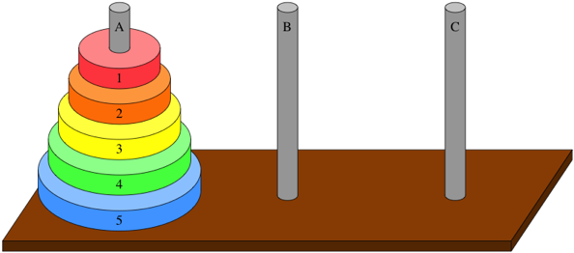
What is a subproblem?

Slide 4
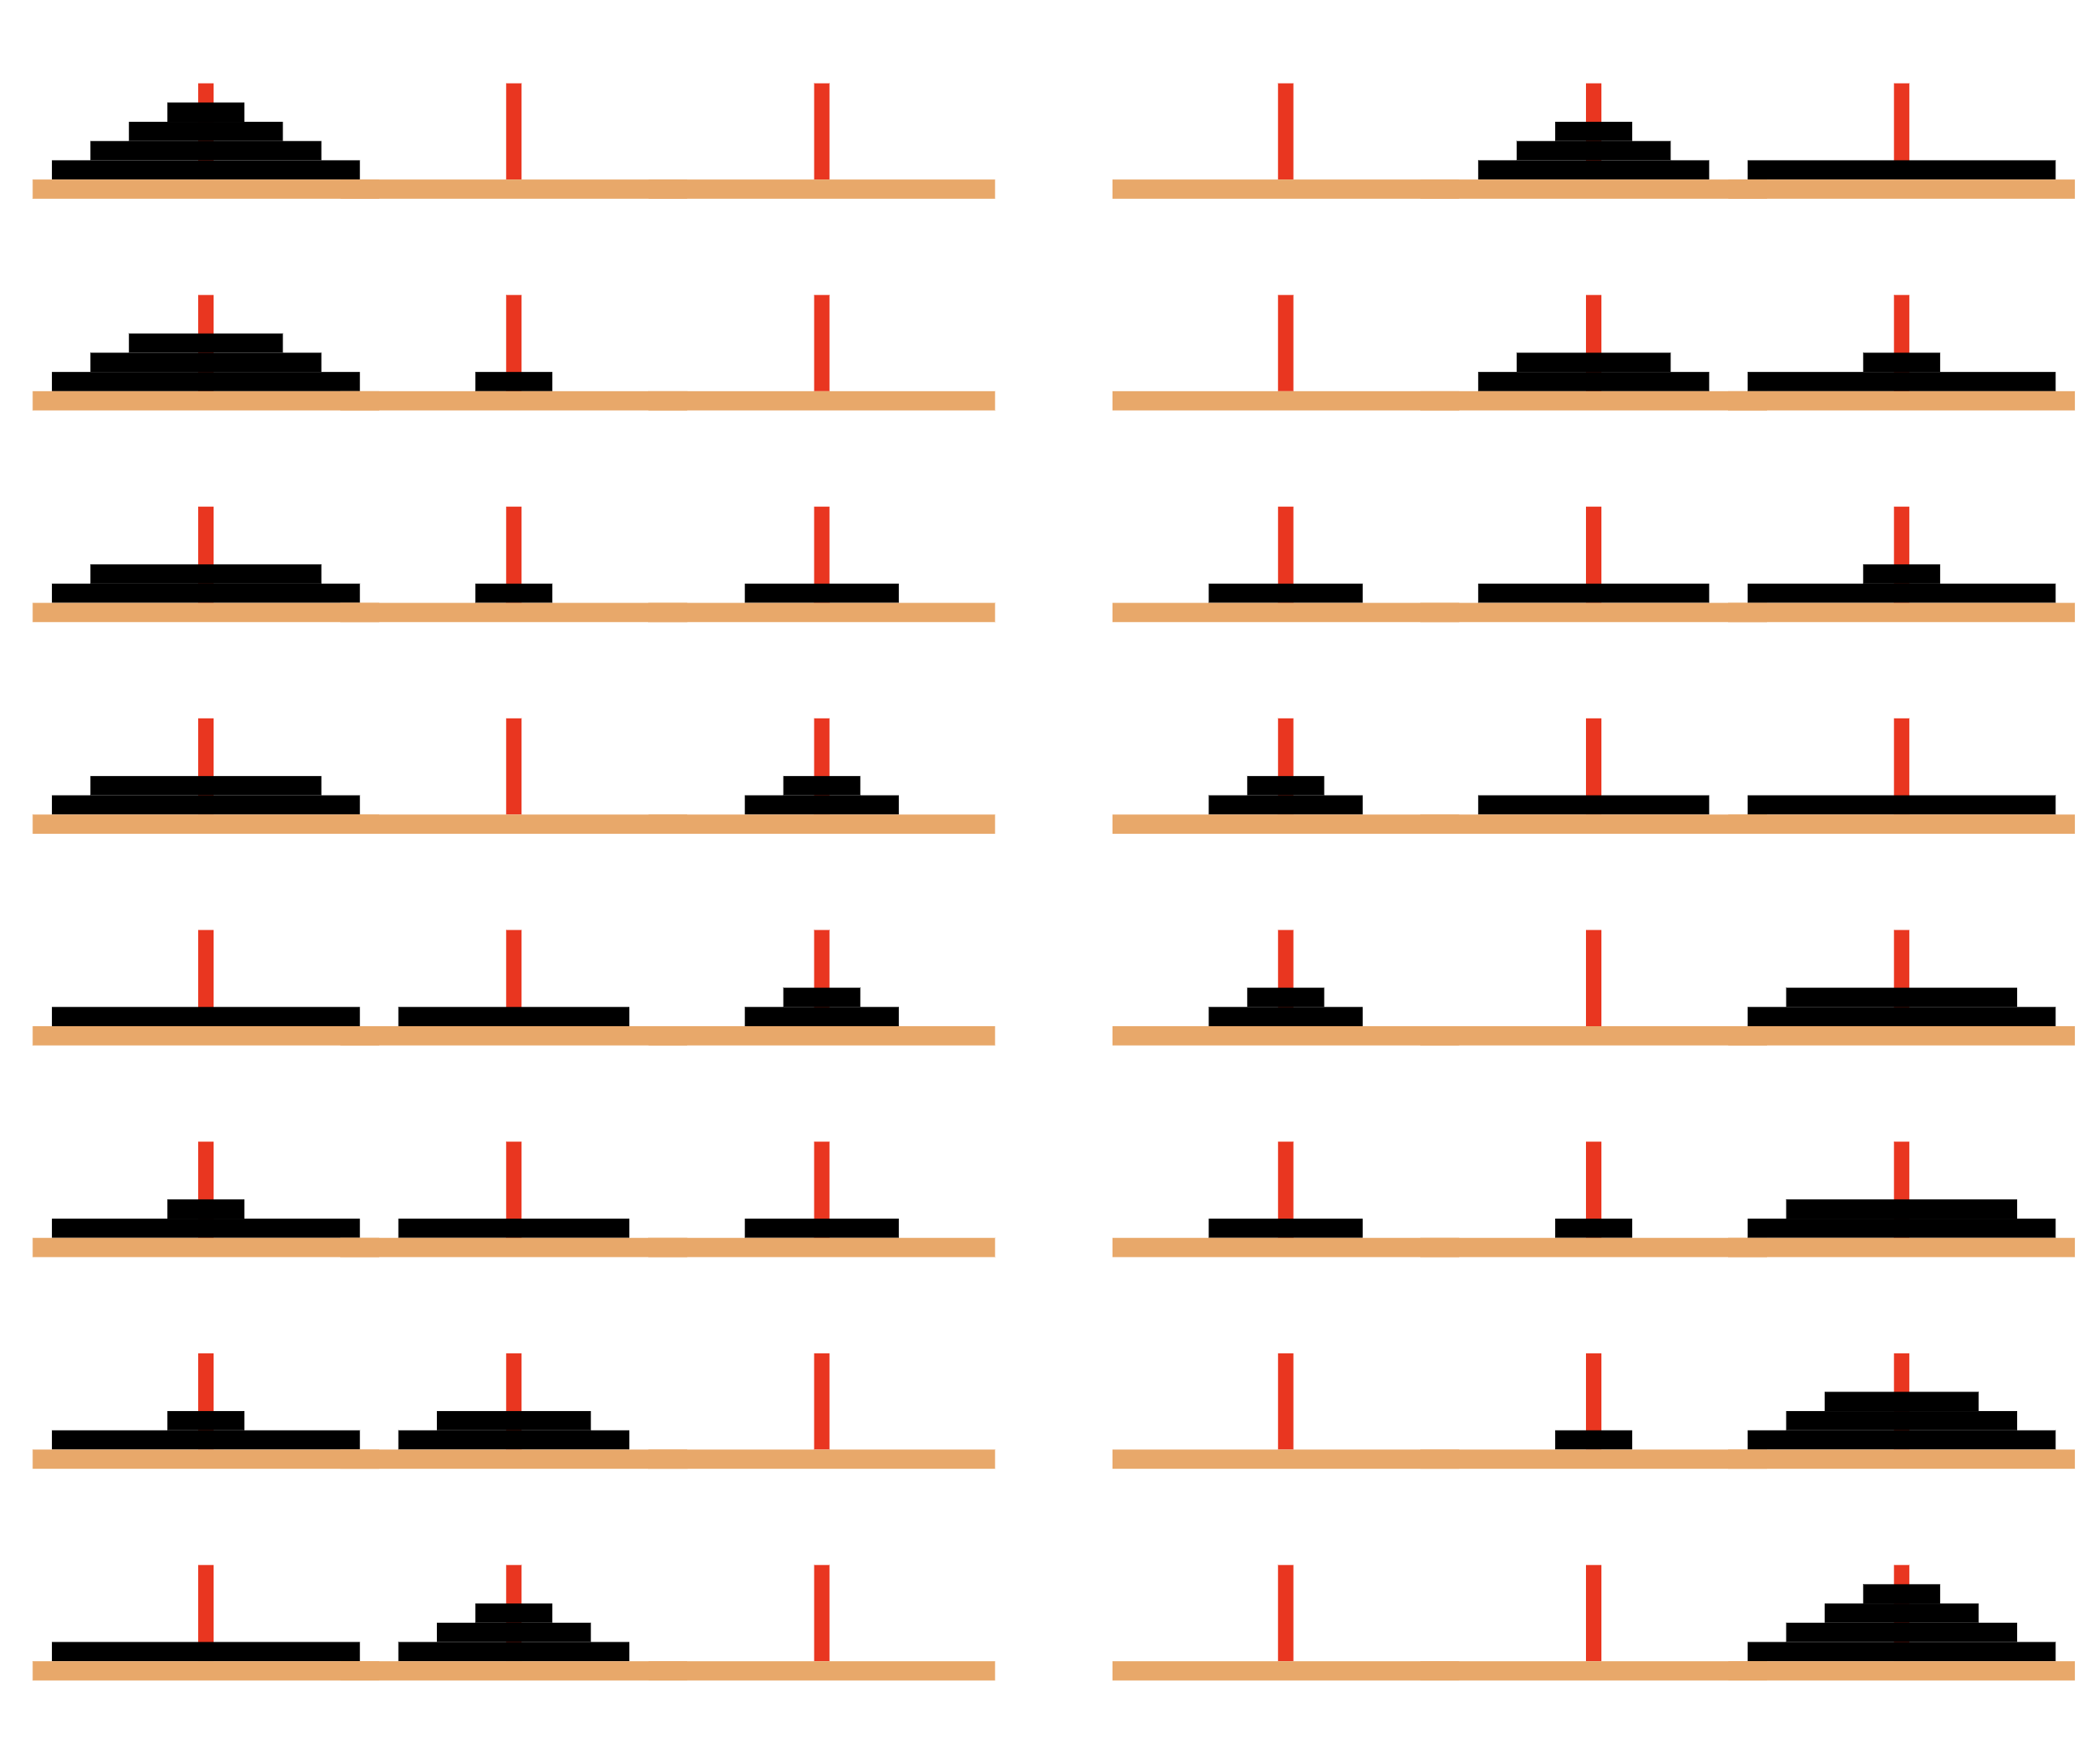

Slide 5
function moveDisks(n, SRC, DEST, SPARE):
if n == 1:
print("Move disk from", SRC, "to", DEST)
else:
moveDisks(n-1, SRC, SPARE, DEST)
print("Move disk from", SRC, "to", DEST)
moveDisks(n-1, SPARE, DEST, SRC)

Slide 6
Dynamic Programming
Overlapping Subproblems: The same subproblems are solved multiple times.
Optimal Substructure: If an optimal solution can be constructed efficiently from optimal solutions of its subproblems.

Slide 7
Dynamic Programming
Approaches:
Top-Down (Memoization): Solve the problem by breaking it down into subproblems, solving each only once and storing their solutions.
Bottom-Up (Tabulation): Start solving from the simplest subproblem, gradually combining solutions to build solutions to more complex problems.

Slide 8
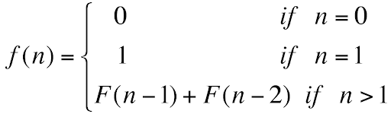
Fibonacci

Slide 9
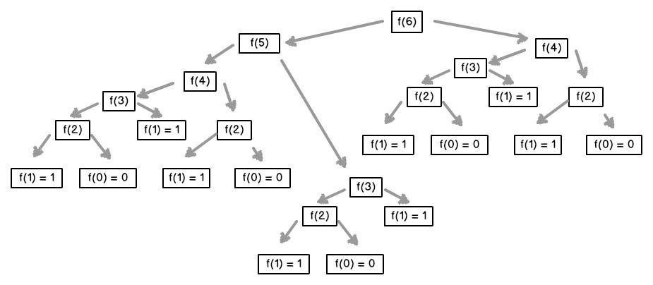
Fibonacci

Slide 10
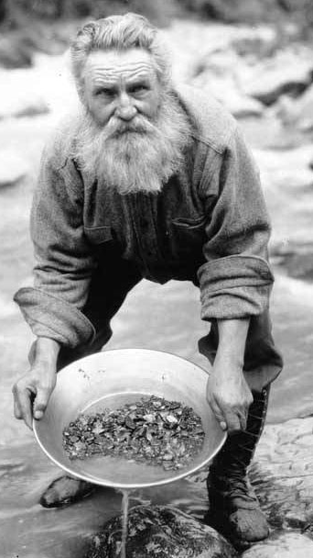
Gold Mine
1 |  |  | 8
 | 5 | 3
3 |  | 2 | 9
 | 7 |  | 1 | 8
2 | 10 |  | 7

Slide 11
Skipping Problem
Navigate through a sequence with the objective of minimizing total cost.
Each step has an associated cost, and the we can choose to either take the step, thereby incurring its cost, or skip it, to potentially reduce overall expenditure.
A simplified model for various real-world scenarios, such as planning routes with tolls, or scheduling tasks with associated costs and flexible deadlines.

Slide 12
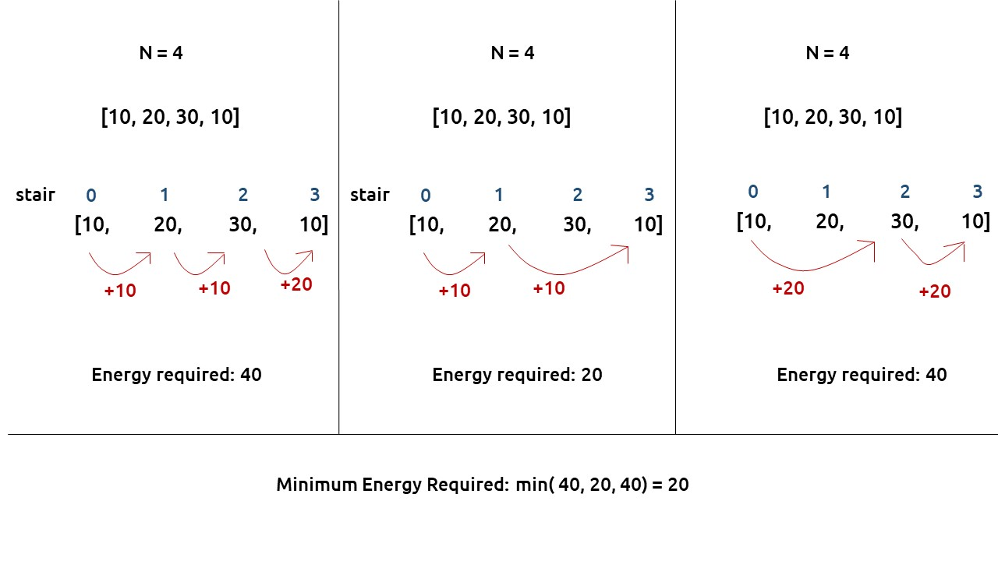

Slide 13
Function minimizeCost(steps):
Initialize dp array of size equal to steps.length
dp[0] = steps[0]
dp[1] = min(steps[0], steps[1])
For i from 1 to steps.length - 1:
dp[i] = steps[i] + min(dp[i-1], dp[i-2])
return dp[steps.length - 1]

Slide 14
Greedy Algorithms
Build up a solution piece by piece, always choosing the next piece that offers the most immediate benefit.
Local Optima Lead to Global Optima
No Backtracking: Once a choice is made, the algorithm never reverses or reconsiders it.

Slide 15
Greedy Algorithms
Criteria for Greediness:
Greedy Choice Property: A global optimum can be arrived at by making a locally optimal (greedy) choice.
Optimal Substructure: an optimal solution to the entire problem contains the optimal solutions to the sub-problems.

Slide 16
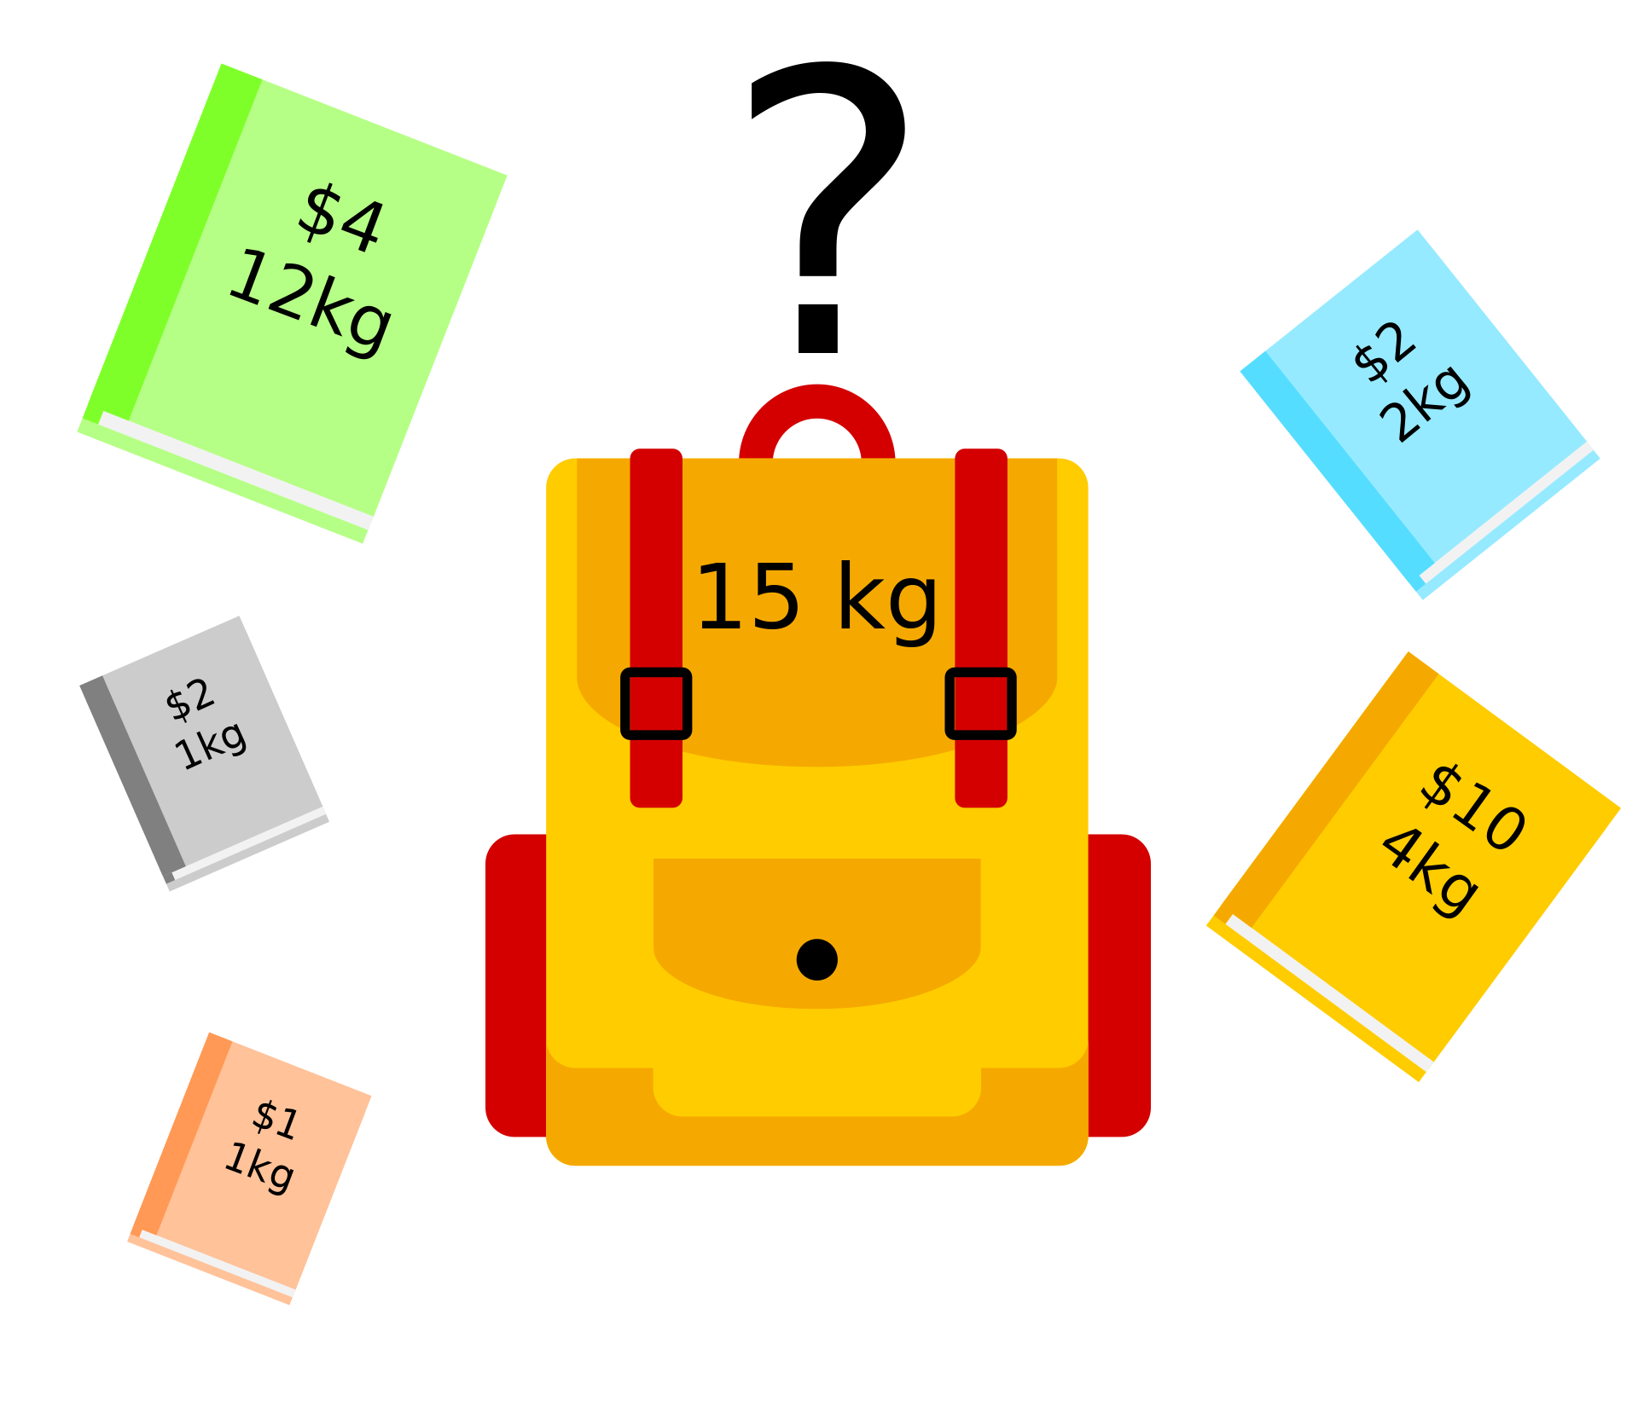

Slide 17
0/1 Knapsack Problem
Description:
In the 0/1 Knapsack Problem, you are given a set of items, each with a weight and a value.
The goal is to determine the number of each item to include in a collection so that the total weight is less than or equal to a given limit, and the total value is maximized.
However, each item can be taken or left (hence "0/1"), meaning you cannot take a fraction of an item or take an item more than once.

Slide 18
0/1 Knapsack Problem
Choosing the items with the highest value-to-weight ratio (a greedy strategy) does not guarantee an optimal solution.
Instead, it is typically solved using dynamic programming or backtracking to ensure that the optimal combination of items is found.

Slide 19
Fractional Knapsack Problem
The goal is to determine the number of each item to include in a collection so that the total weight is less than or equal to a given limit, and the total value is maximized.
This variant gives you a set of items, each with a weight and a value, and the goal is to maximize the total value in the knapsack while keeping the total weight under a limit.

Slide 20
Fractional Knapsack Problem
The Fractional Knapsack Problem can be solved using a greedy approach.
The strategy involves taking items in order of their value-to-weight ratio, starting with the highest.
This approach works because you can take fractions of items, ensuring the knapsack is filled to maximum capacity without exceeding the weight limit.

Slide 21
Fractional Knapsack
“knapsack”
Solution:
1 ml of 5
2 ml of 3
6 ml of 4
1 ml of 2
Items:
1
2
3
4
5
Weight:
4 ml
8 ml
2 ml
6 ml
1 ml
Benefit:
$12
$32
$40
$30
$50
10 ml
Value:
3
4
20
5
50
($ per ml)

Slide 22
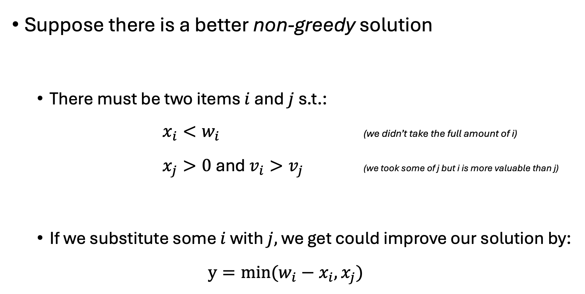
Suppose there is a better non-greedy solution
There must be two items $i$ and $j$ s.t.: $x_{i}<w_{i}$ (we didn’t take the full amount of i) $x_{j}>0$and $v_{i}>v_{j}$ (we took some of j but i is more valuable than j)
If we substitute some $i$ with $j,$ we get could improve our solution by:
$$y=min⁡(w_{i}−x_{i}, x_{j})$$

Slide 23
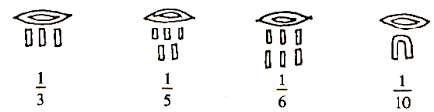
Egyptian Fractions
Egyptian fractions are a form of fraction notation which date back to Ancient Egypt, where every fraction is represented as a sum of unique fractions with numerator 1.
Unlike the fractions we commonly use today, Egyptian fractions do not allow the numerator to be greater than 1.
Given any ordinary fraction, convert it into an Egyptian fraction.

Slide 24
Egyptian Fractions
Input: A fraction represented as two integers, numerator and denominator.
while numerator > 0:
Calculate the ceil of the division denominator / numerator, let this be x
Set 1/x as part of the Egyptian fraction representation.
Update numerator to numerator * x - denominator.
Update denominator to denominator * x.
Reduce numerator and denominator to their simplest form.

Slide 25
Example: 3/7
Calculate ceiling of denominator/numerator = ceil(7/3) = 3.
The first unit fraction is 1/3.
Update numerator: numerator = 3 * 3 - 7 = 2.
Update denominator: denominator = 7 * 3 = 21.
The fraction is now 2/21.
Calculate ceiling of denominator / numerator = ceil(21/2) = 11.
The second unit fraction is 1/11.
Update numerator: numerator = 2 * 11 - 21 = 1.
Update denominator: denominator = 21 * 11 = 231.
The fraction is now 1/231.
The original fraction 3/7 can be represented as the sum of
1/3 + 1/11 + 1/231.

Slide 26
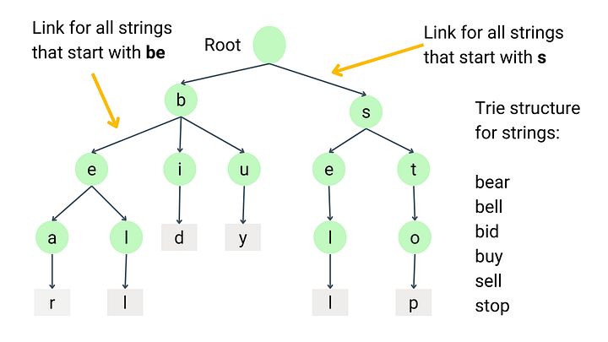

Slide 27
Trie Complexity
K is the key length,
S is the size of the alphabet,
N is the size of the trie (total number of nodes).
Operation | Complexity | Notes
Insertion | O(K) | Independent of the alphabet size S as each level of the trie represents a character in the key.
Search | O(K) | Like insertion, depends on the length of the key.
Deletion | O(K) | Requires traversing the key and possibly deleting nodes.
Prefix Search | O(K+M) | M is the total number of characters in the output. This includes the time to find the prefix (O(K)) and then to traverse the subtree rooted at the prefix node to gather all keys (M).
Space Complexity | O(S⋅N) | In the worst case, each node could have pointers to S other nodes, leading to a space complexity proportional to the product of the size of the alphabet and the number of nodes.

Slide 28
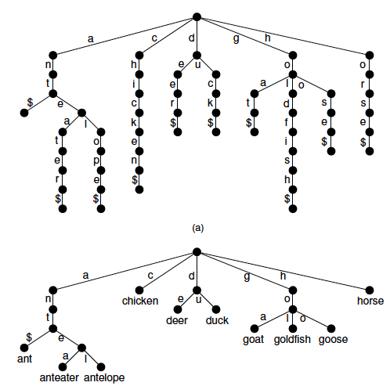

Slide 29
Pattern Matching

Slide 30
Boyer-Moore Heuristics

Slide 31
KMP
j | 0 | 1 | 2 | 3 | 4 | 5
P[j] | a | b | a | a | b | a
F(j) | 0 | 0 | 1 | 1 | 2 | 3

